Slide 1
The Posture-Inator
Group A
Jon Ali, Aurielle Barnett, Gabe Botero, Riley Forster, Jennifer Yang

Slide 2
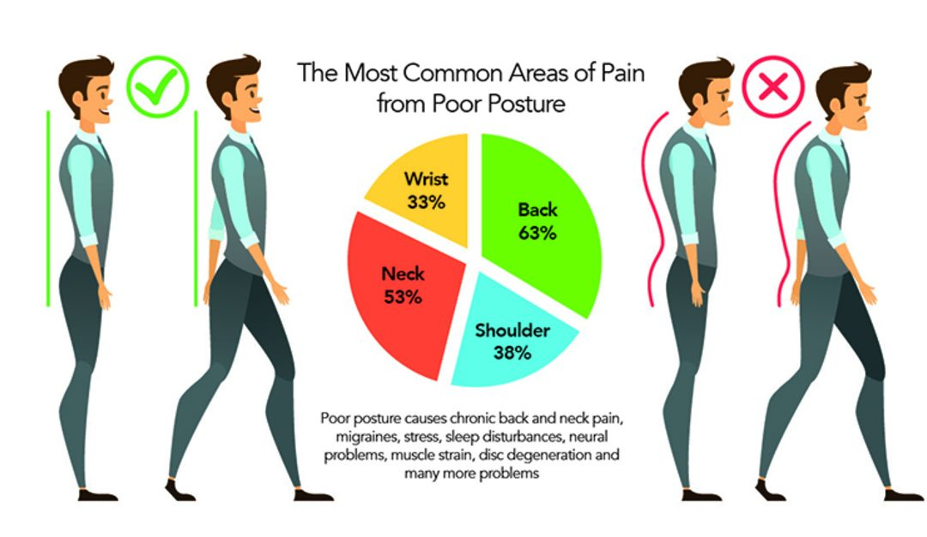
The Posture-Inator
Problem
Poor posture can lead to chronic pain
Common in office workers and students
Source: https://www.metrophysio.co.uk/blog/common-areas-pain-poor-posture/

Slide 3
Opportunity and Design Problem
Design Opportunity
Current posture aids lack user feedback and accurate posture sensing
Design Problem
Design and build a device that can:
Sense posture
Provide feedback when user has poor posture
Attach to a chair

Slide 4
Stakeholders and Design Requirements
Stakeholders
Customers looking to improve their posture
Medical professionals who advise patients on correct posture and help with correction
Design Requirements
Applicable to assorted chairs
Usable for various body shapes and sizes
Non-intrusive to the user

Slide 5
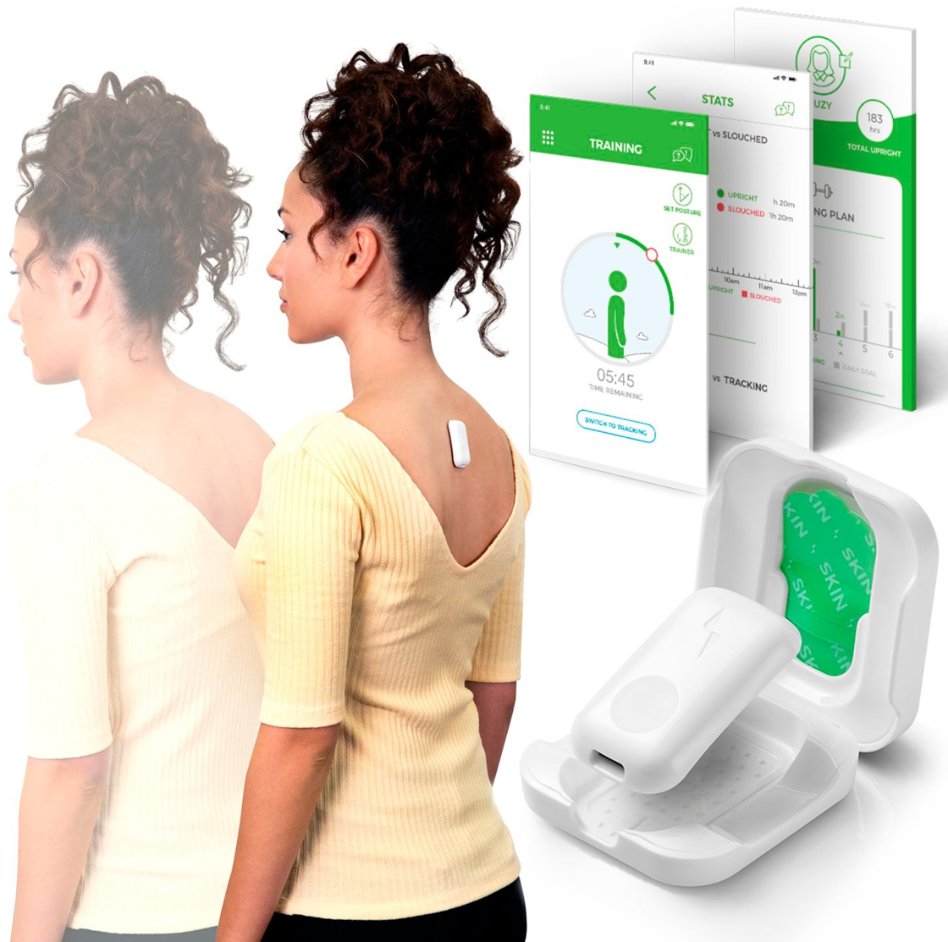
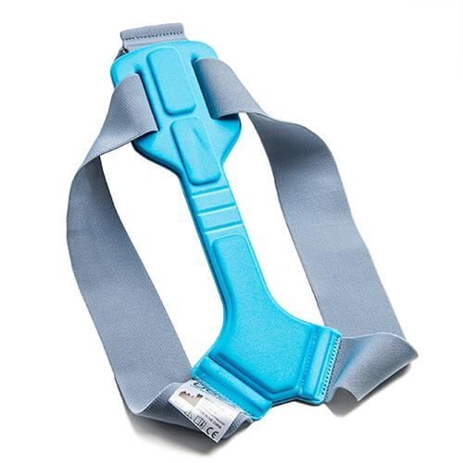
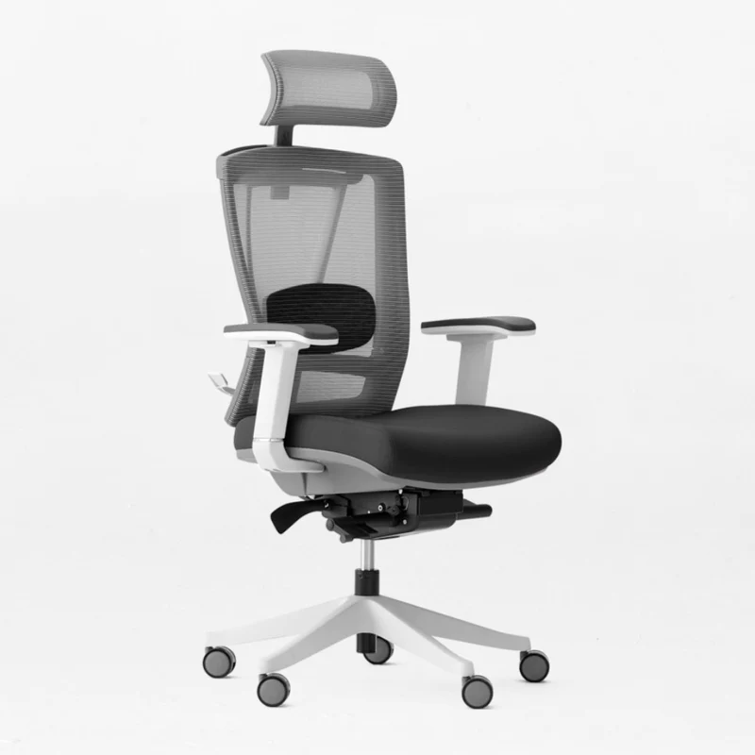
Existing Solutions and Technologies
Upright Go
Description
Meant to physically attach to user, utilizes sensors to detect and correct posture
Shortcomings
Device only targets the back area
False positives
Adhesive design & quality control
Posture Braces
Description
Meant to be worn by user, restriction of movement through tension
Shortcomings
Device only targets one specific area of body
Uncomfortable, awkward to wear
Risk of injury, muscle atrophy
Ergonomic Chair
Description
Features added to increase chair’s ability to adjust to user’s body
Shortcomings
Reliant on user customization
Can’t provide any feedback or correction to user
Notes:
Communicate state of art solutions:
How do they address the problem?
What are their shortcomings?
How will our solution better address the problem?

Slide 6
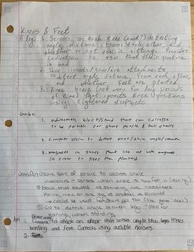
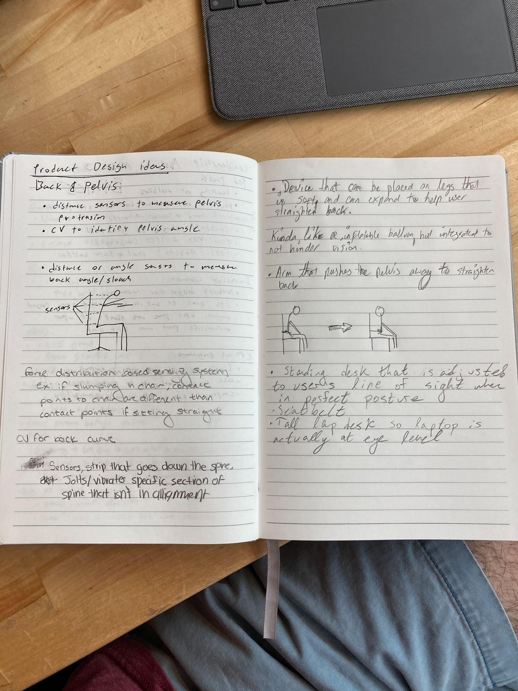
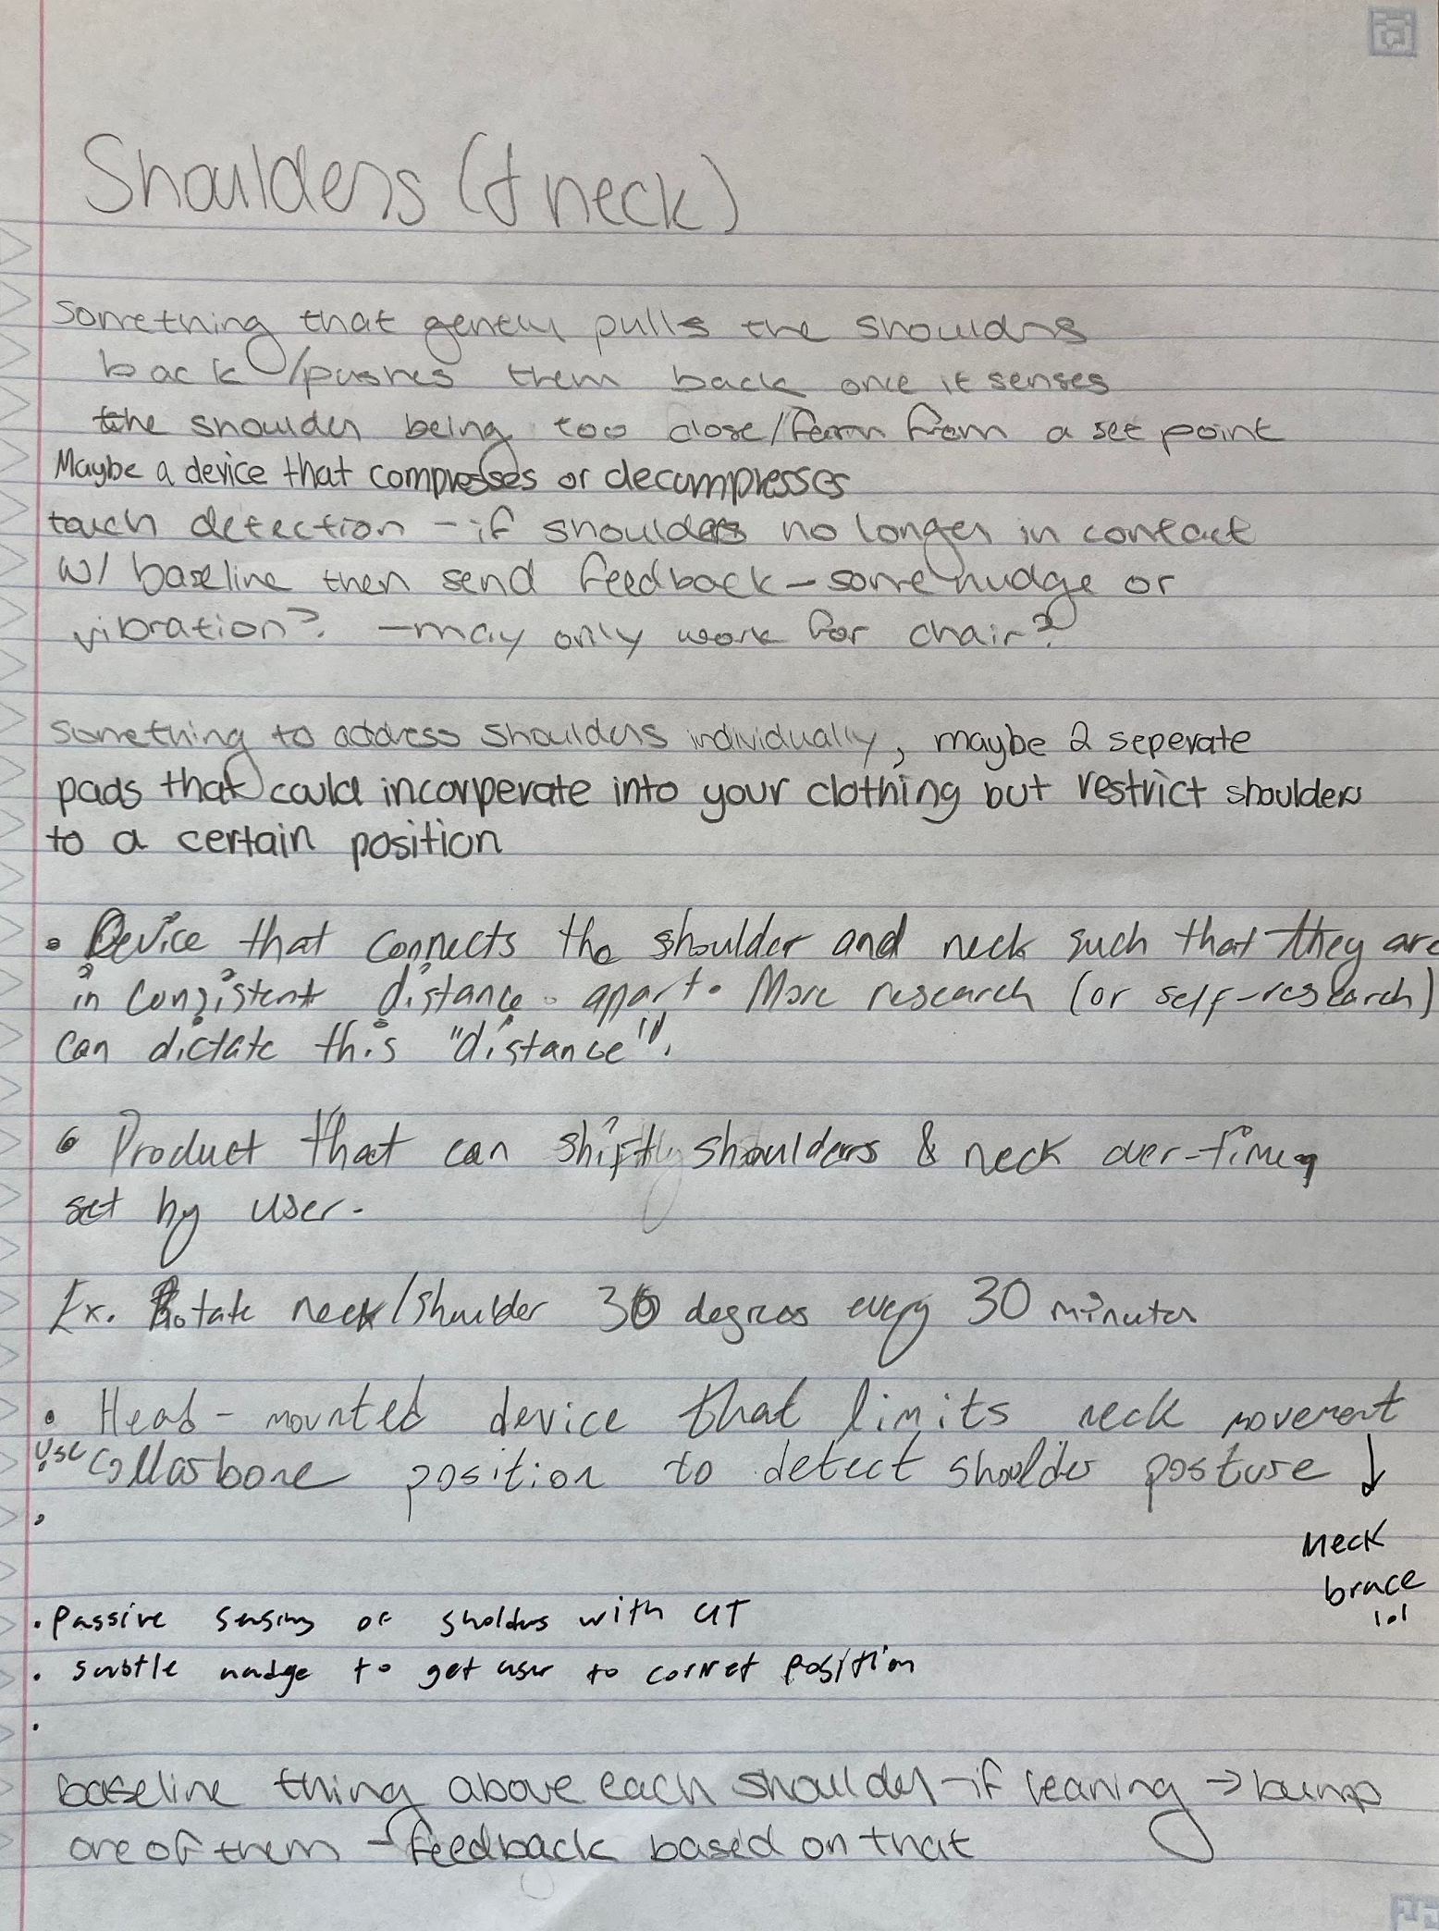
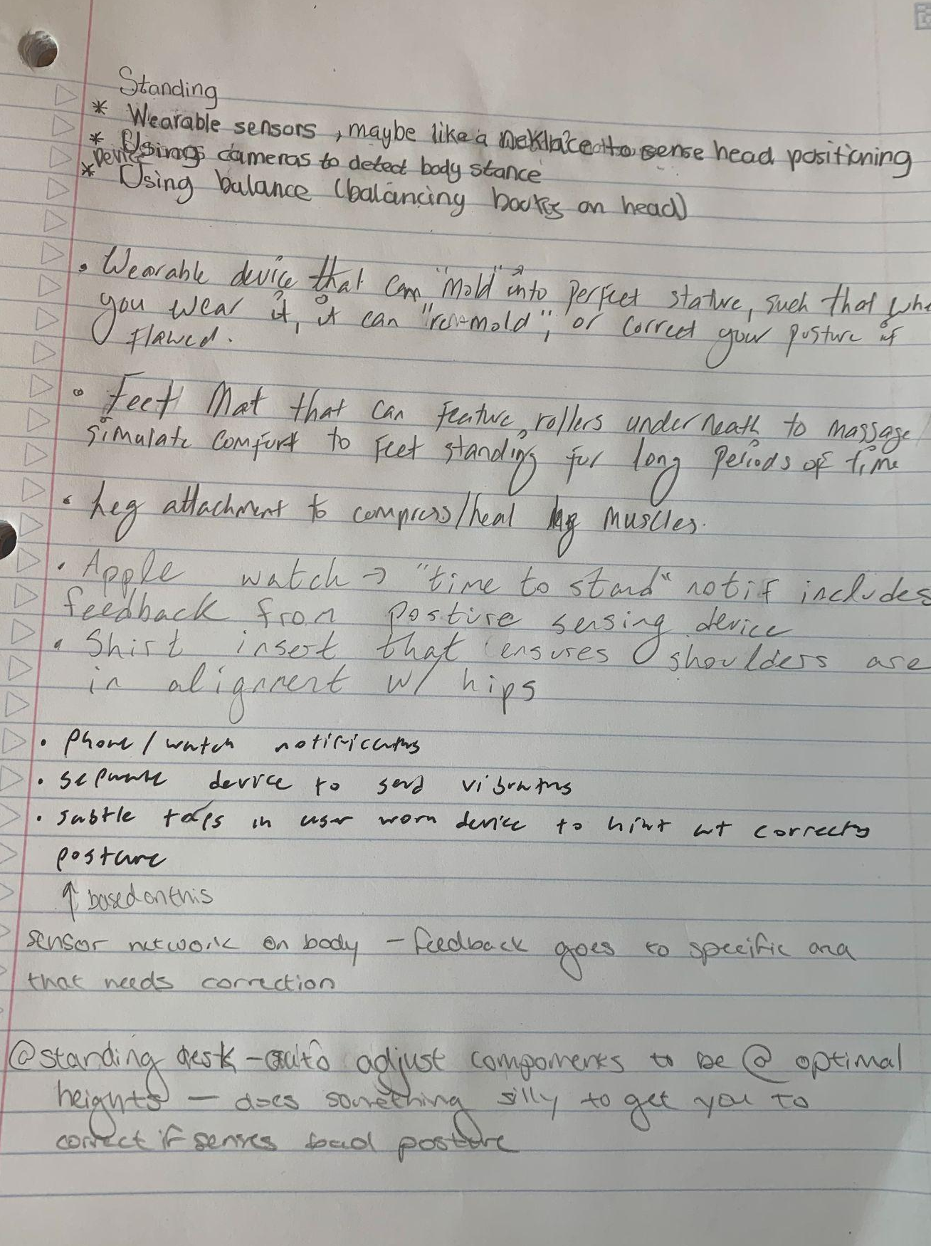
Concept Generation
Used customer and market research to determine categories of posture correction solutions
Sitting
Standing
Shoulders and neck
Back and pelvis
Knees and feet
6-3-5 method
Notes:
Describe your design concepts
Explain what the different design concepts are and how they work
Explain why you selected your concept
Explain the key criteria used to evaluate the concepts
Describe why the chosen concept out-performs the others

Slide 7
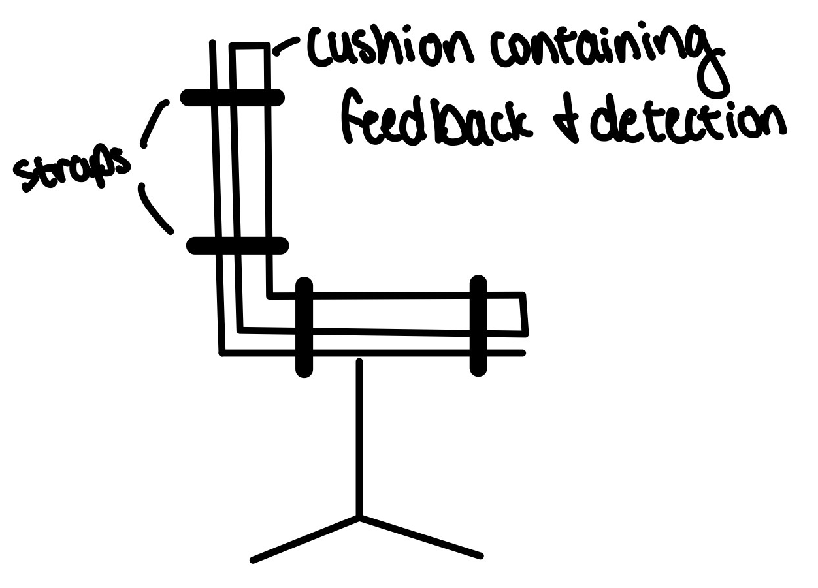
Concept Selection
Design Criteria
Posture Sensing
User Feedback
Device Attachment
Pugh Chart
Selected Concept
Modified
Gentle tactile feedback
Distance sensing
 |  | Unmodified, Vibration Feedback | Modified, Audible Feedback | Modified, Tactile Feedback
Criteria | Weight | Design 1 | Design 2 | Design 3
Low Cost | 2 | 0 | 0 | 0
Non Intrusive | 1 | 0 | 1 | -1
Has Sensing Ability | 3 | 1 | 1 | 1
Universality | 1 | 1 | 0 | 0
Low Risk of Injury | 3 | 1 | 1 | -1
Comfortable | 2 | 1 | 0 | 0
 | Total | 9 | 7 | -1
Notes:
Posture sensing: force, distance, pressure, motion sensors
User feedback: audio, vibration, tactile feedback
Device attachment: unmodified, modified, areas of the chair
Pugh chart
Selected concept: modified - most design freedom, tactile feedback - most different from existing products, distance sensing - similar to motion sensing on the body but less invasive

Slide 8
Engineering Challenges
Mechanical Attachment
Clamping system
Strap
Suction
Motor-Sensor Configuration for “nudge”
Choosing moderately powerful motor, sensor type (tactile, etc) and microcontroller (Arduino, Raspberry Pi, etc)
Integrating microcontroller and sensor with mechanical design
Sensor Feedback/Reading
Processing sensor data
Consolidating for user to read and enhance feedback

Slide 9
Prototyping (PT) Plan
Key Subsystems to prototype:
Connection to chair
Sensor array
User feedback system
Steps to proof of concept
PT1: Chair connection, Sensors and feedback constructed
PT2: Sensors integrated with chair, and connected to user feedback via software
PT Testing
User testing
Notes:
Should do prototype 0 - mock up the feedback to the user (ex: vibrate phone and mimic the feedback - get tested feedback types before deciding on a feedback type)
What sensors do we plan on purchasing? Ultrasonic sensors primarily, have also thought about stereo cameras or force feedback/touchpoints
Engineering challenge: detecting where the different sensors are in relation to themselves - keep different chairs in mind as that changes the sensor network
How would you detect shoulder and neck distance if in a chair that doesn’t have back all the way up - could limit scope or could create a device that raises higher
Considering more limiting scope bc that is what is more commonly seen in
Specify what your tests are - start quantifying that
Order components asap
Use COTS parts when possible

